Slide 1
CS 347 Project
Conner Collins, Hunter Degroot, and Scott Jackson
Github Repo: https://github.com/connercollins/S16D7
Port: 7040

Slide 2
Part 1
Models
Screenshots
SQL Queries

Slide 3
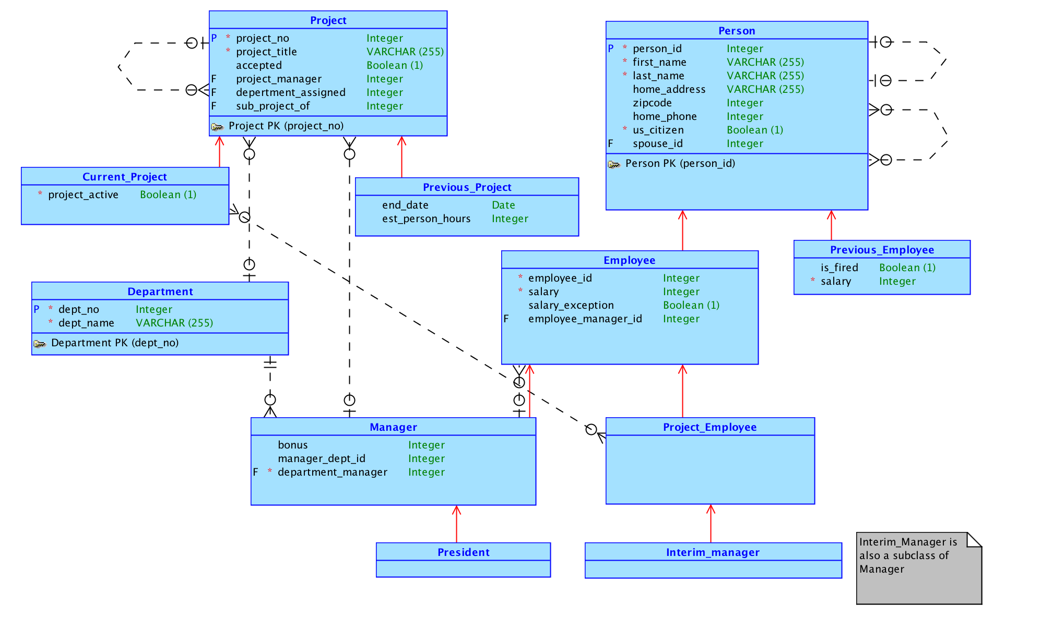
Conceptual Model

Slide 4
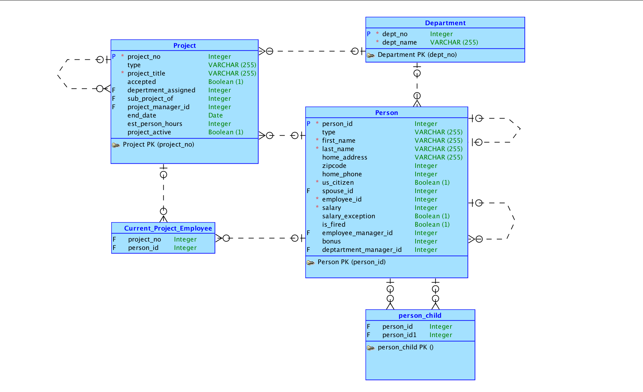
Logical Model

Slide 5
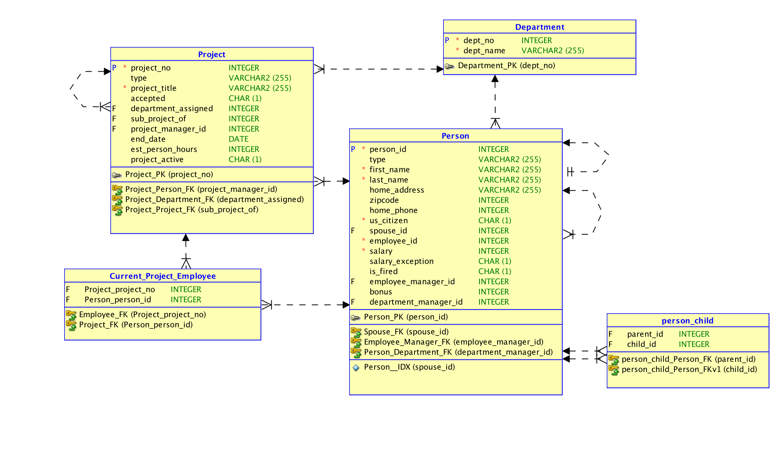
Relational Model

Slide 6
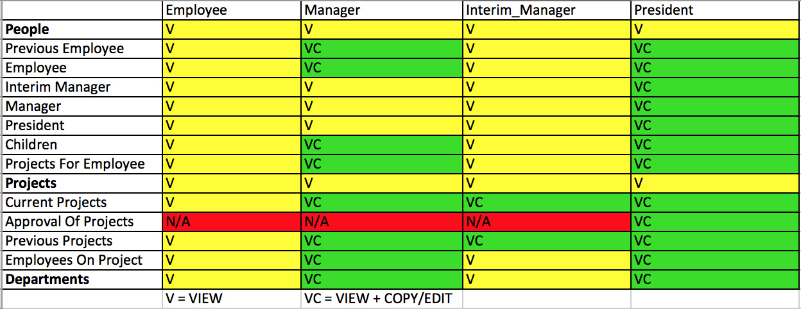
Permissions

Slide 7
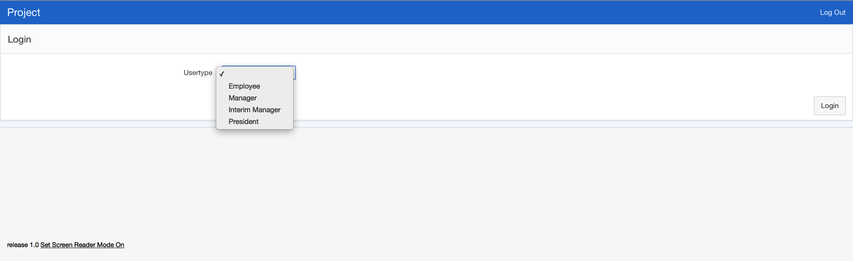
Login

Slide 8
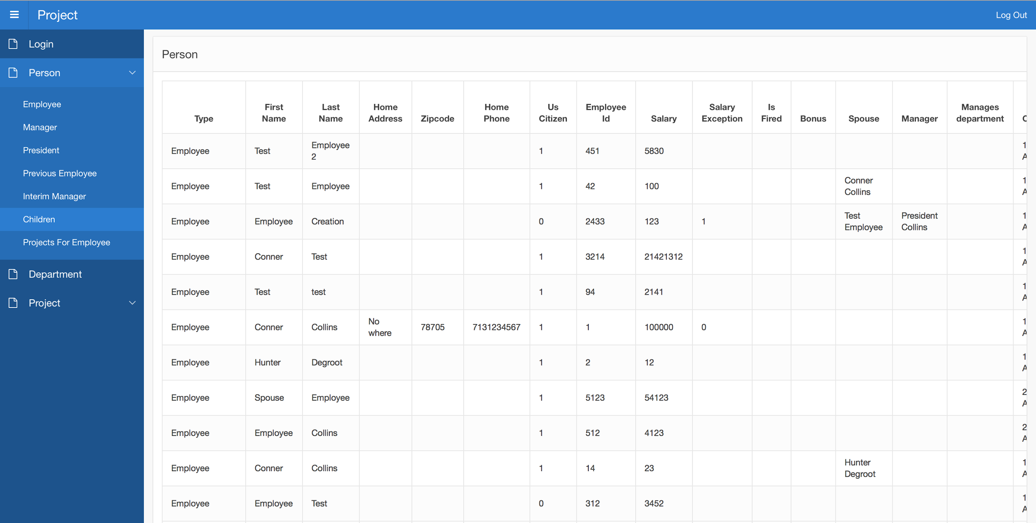
Person

Slide 9
Person Extended

Slide 10
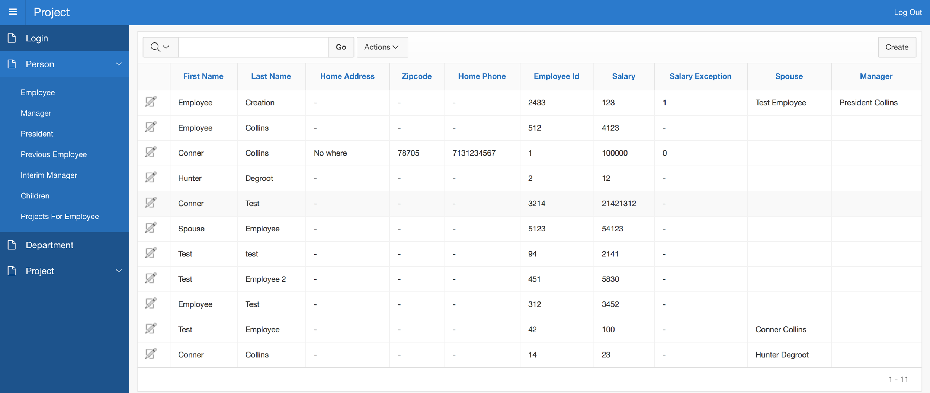
Employee (President View)

Slide 11
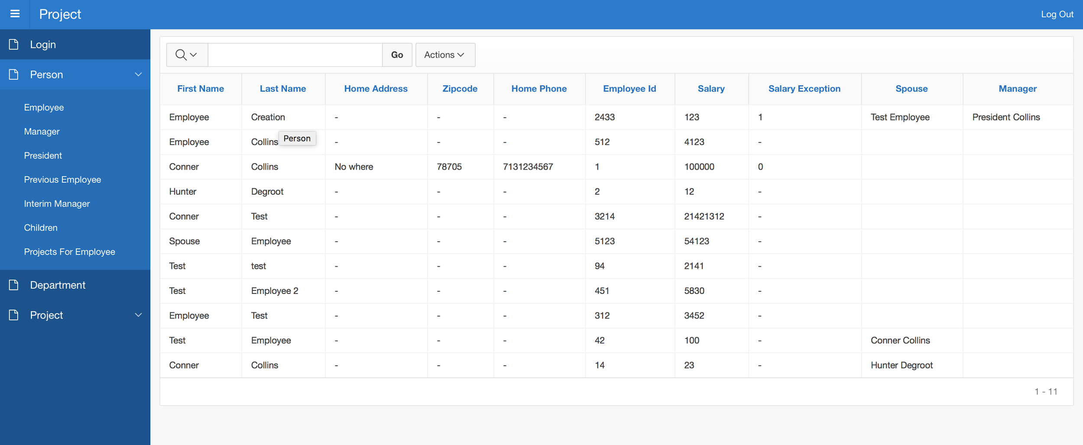
Employee (Employee View)

Slide 12
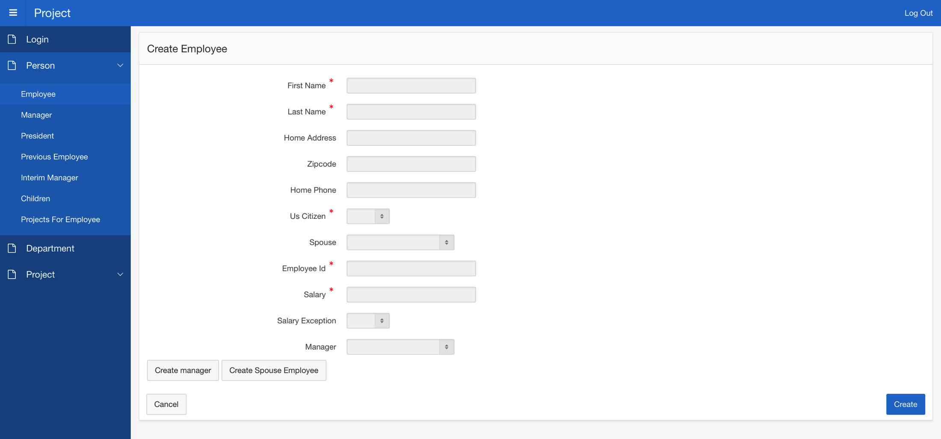
Create Employee

Slide 13
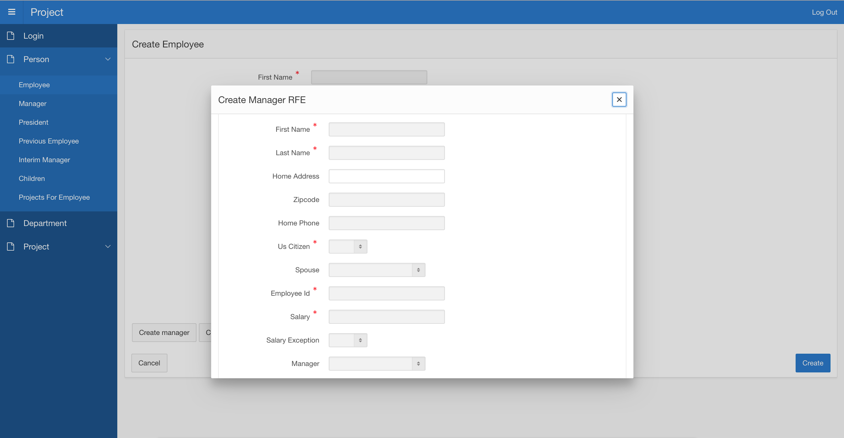
Create Manager Within Employee Form

Slide 14
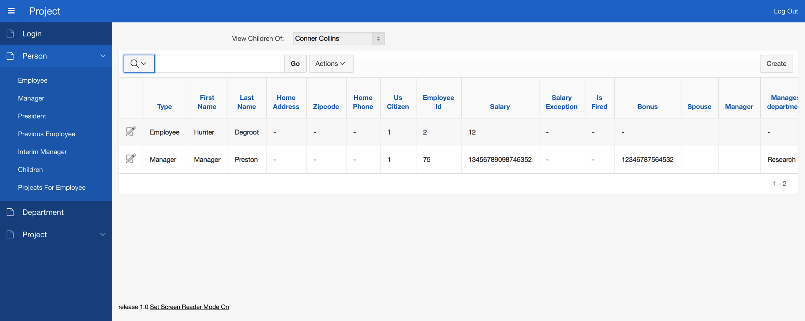
Children Many to Many Relationship

Slide 15
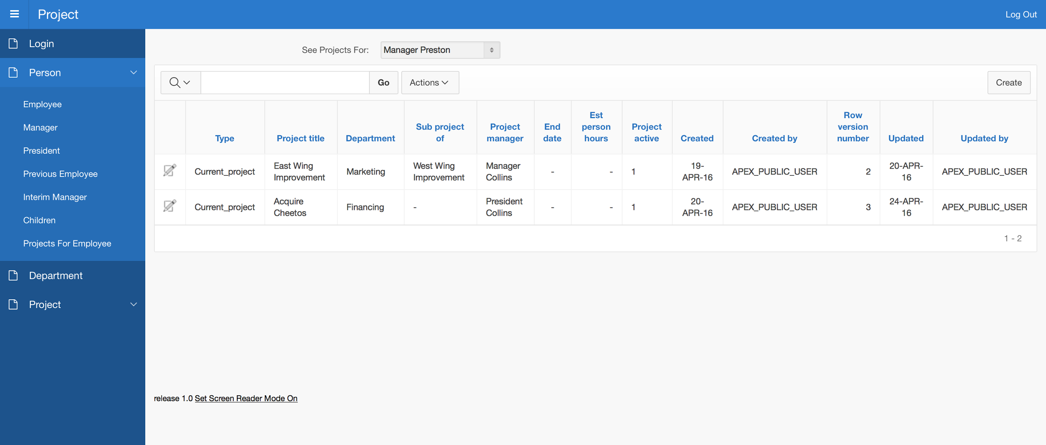
Projects Employees Are On

Slide 16
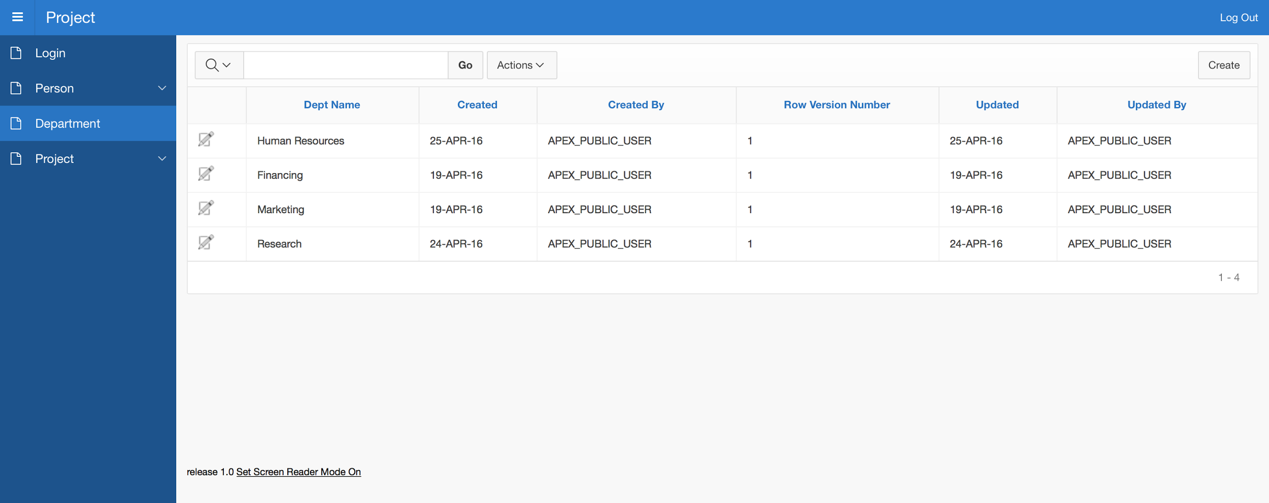
Department

Slide 17
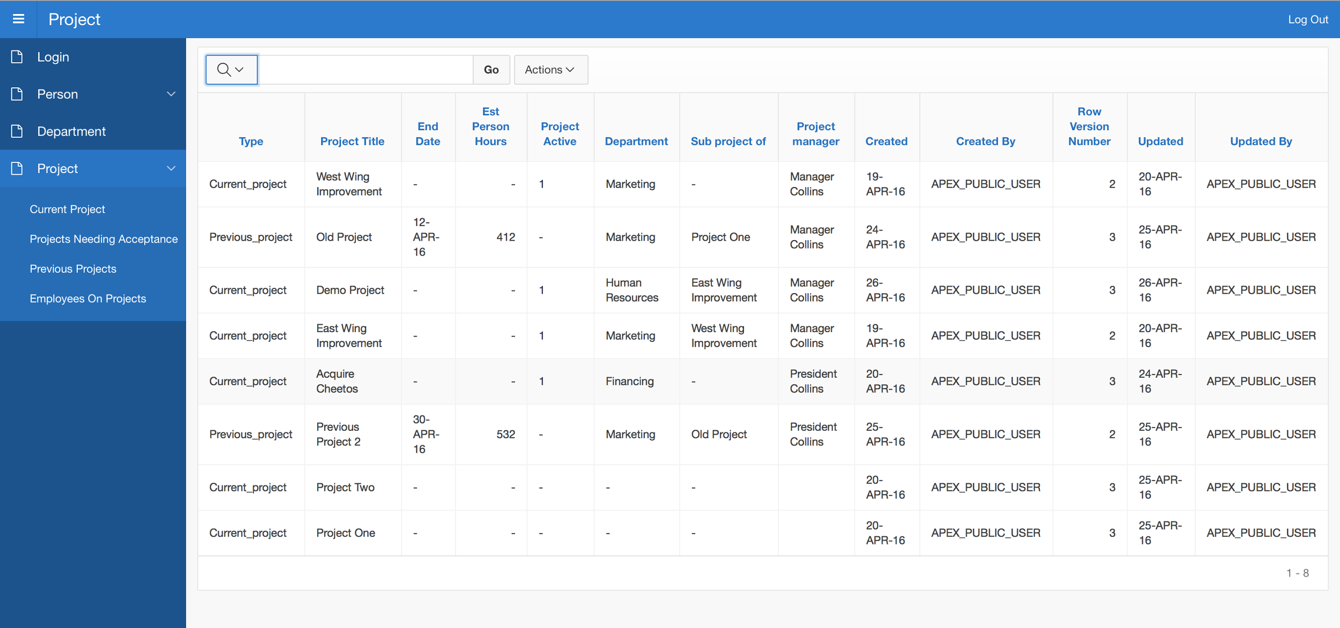
Projects

Slide 18
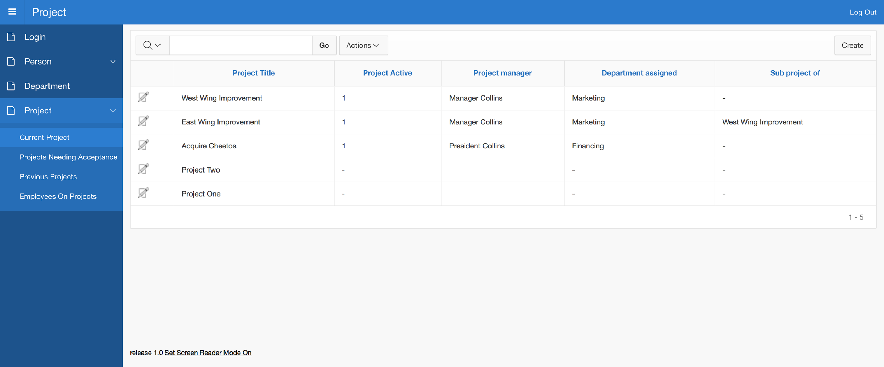
Current Project

Slide 19
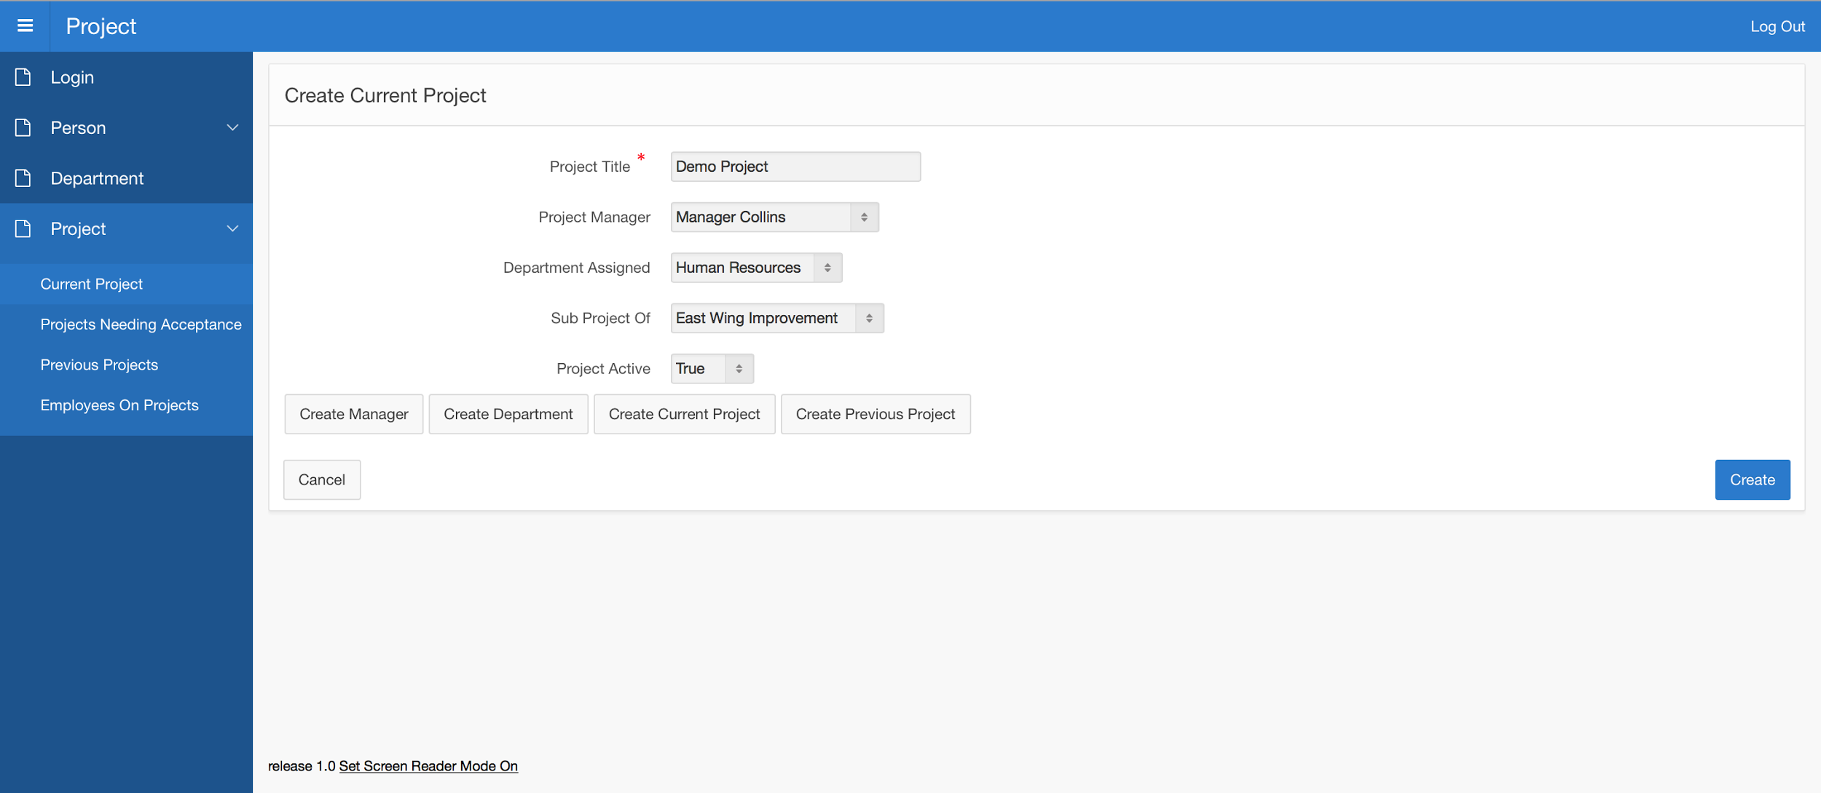
Create Current Project

Slide 20
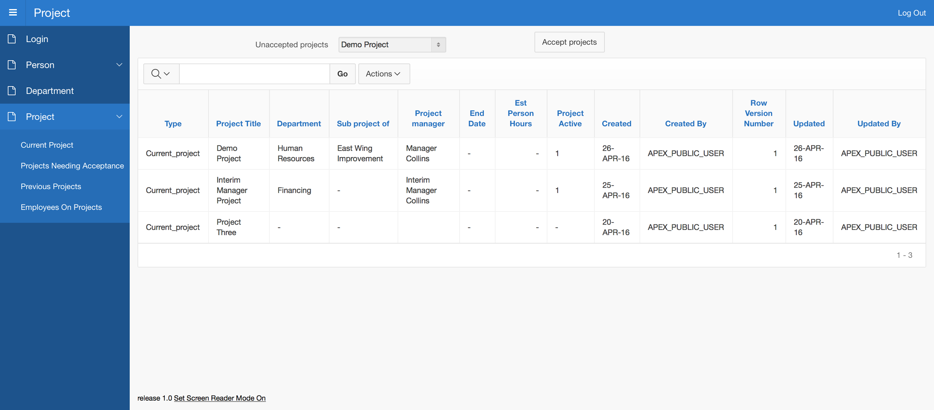
Accept A Project

Slide 21
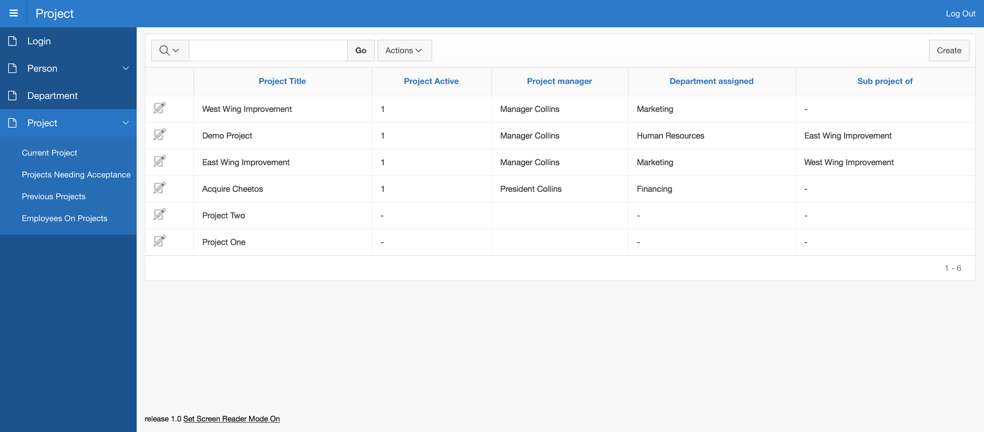
Current Project After Approved

Slide 22
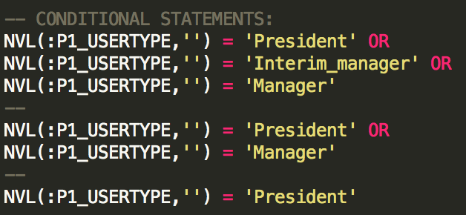
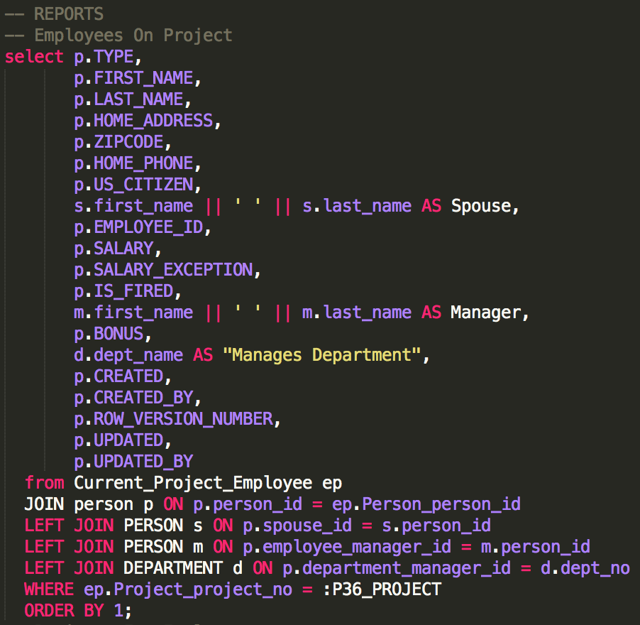
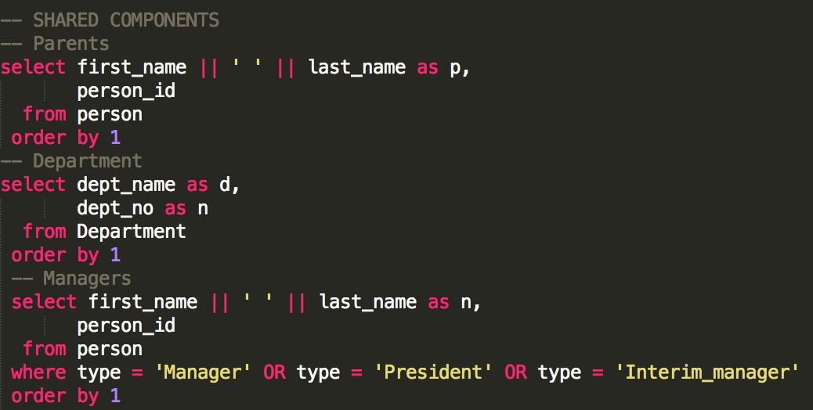
Sample Queries

Slide 23
Part 2
Models
Screenshots
SQL Queries

Slide 24
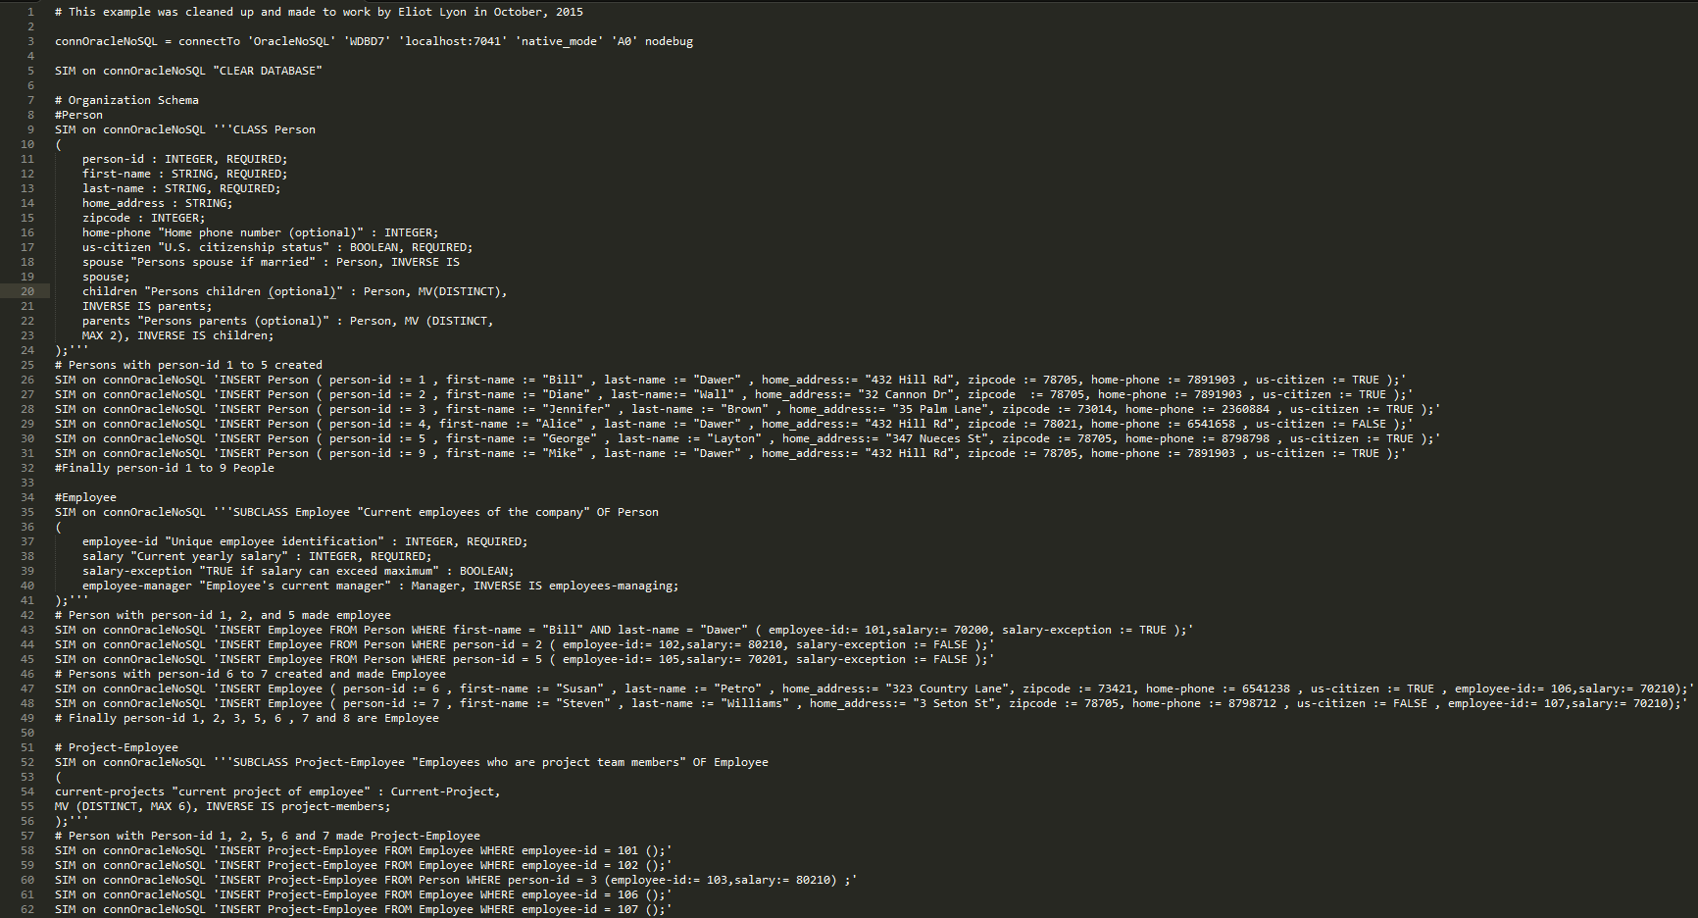
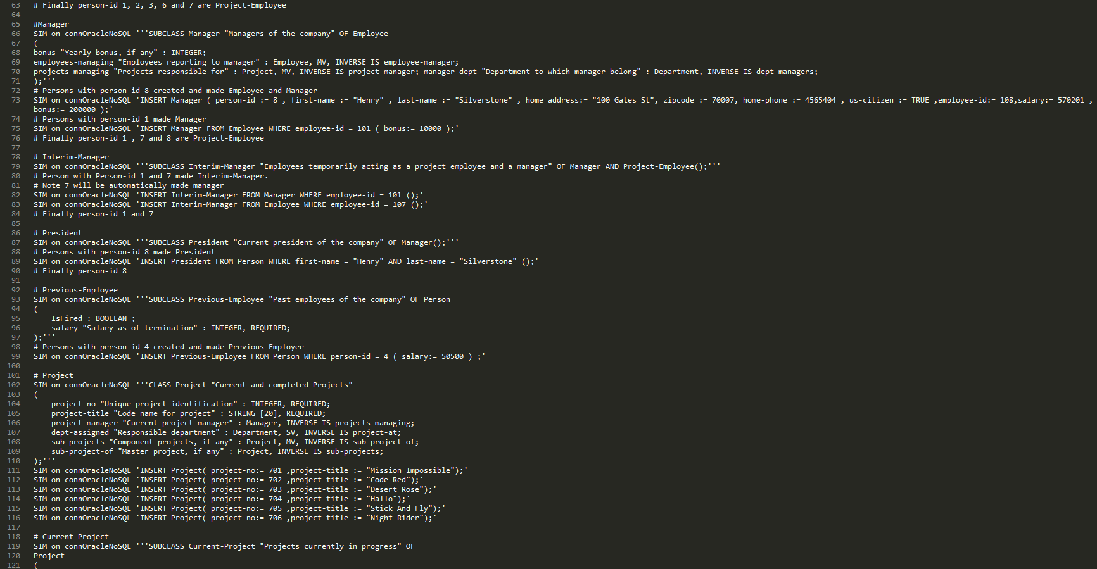
SIM Model

Slide 25
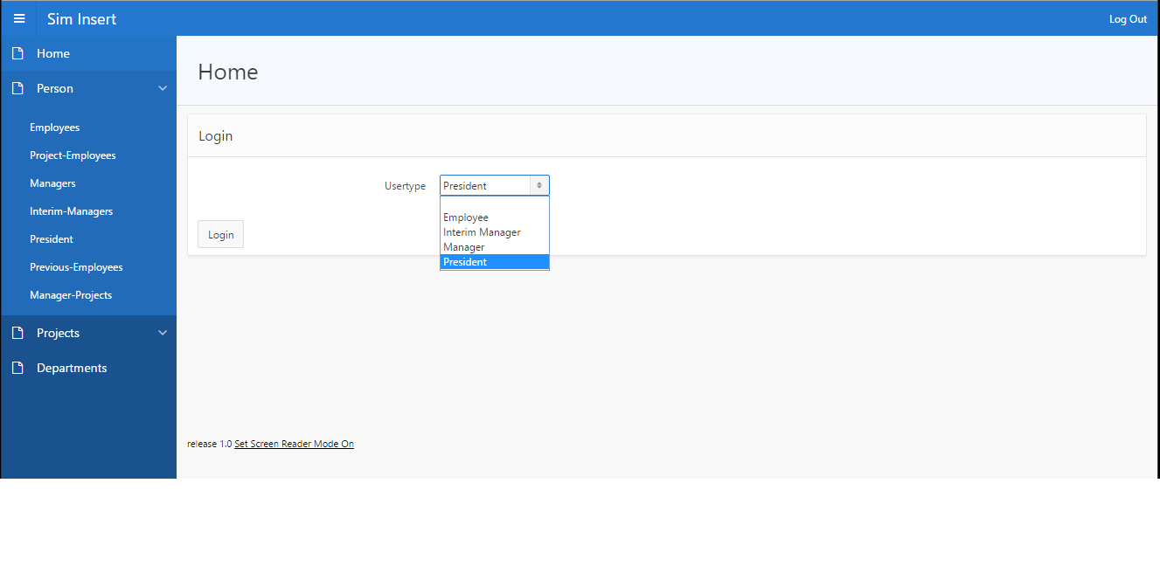
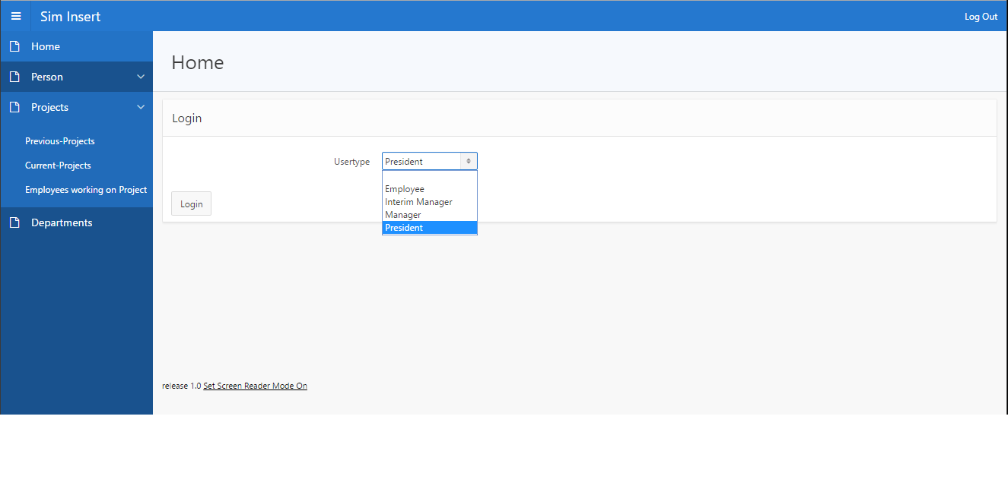
Login and Home

Slide 26
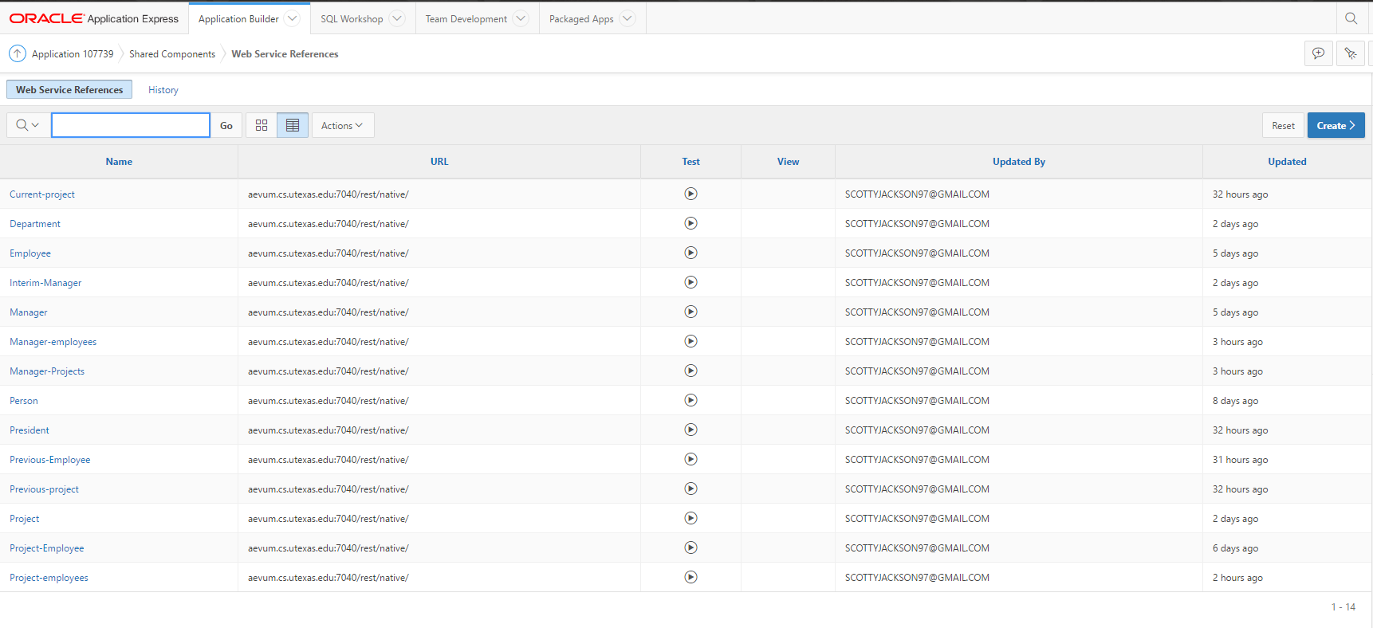
Web Service References

Slide 27
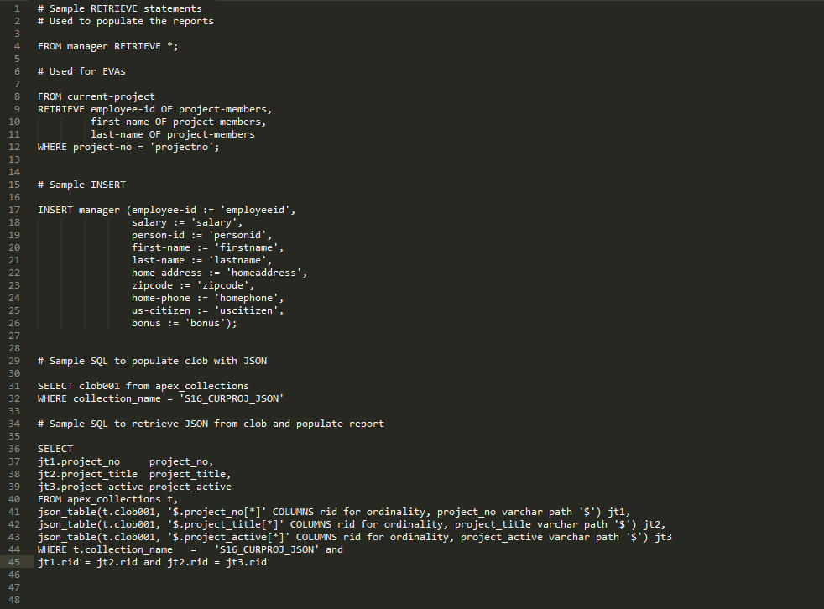
Sample Code

Slide 28
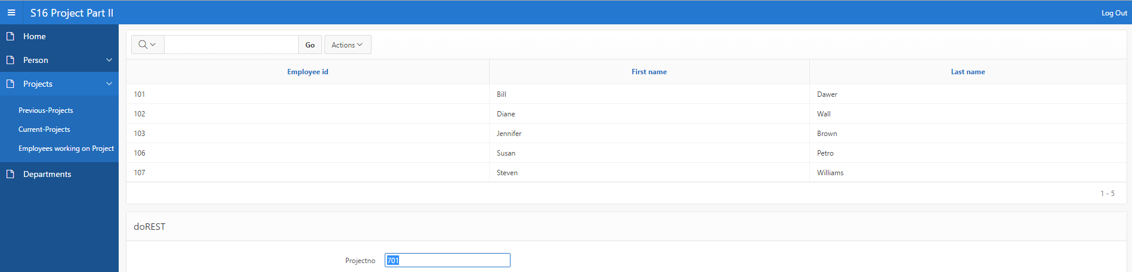
EVA Page

Slide 29
Suggestions for Enhancements
Automatically choose the correct type for inserts
More helpful errors
Unique Constraints
Retrieving from multiple relationships can cause array index out of bounds exceptions
Hiding the query and REST information causes errors
Editing / deleting entries in the DB
A different framework (e.g. Django) could be a better choice for implementation of SIM

